Slide 1
Freiberg High
Pressure Research Center
Behavior of copper-powder in shock-wave synthesis experiments
Thomas Schlothauer, Stefan Martin, Christian Schimpf,
Annia Greif, Gerhard Heide

Slide 2
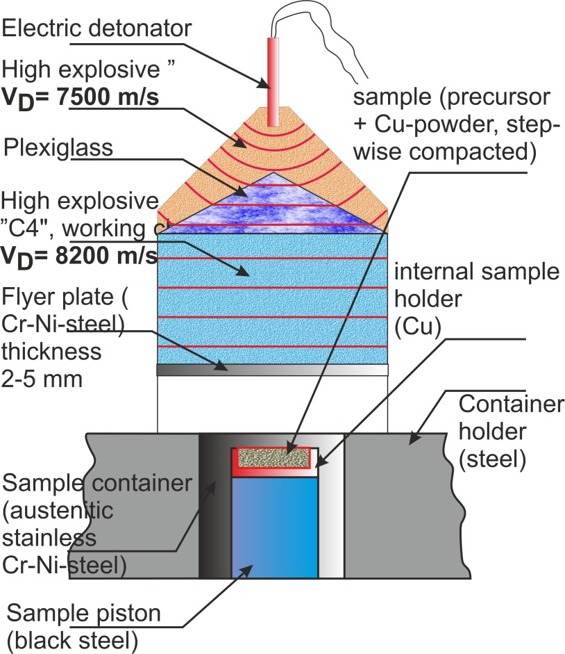
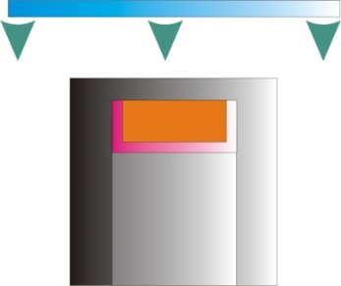
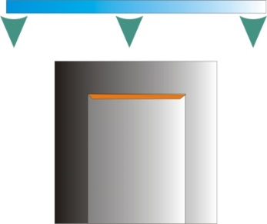
Experimental setup^{[1]}
impedance method
reflection method
Schlothauer, T., G. Heide, K. Keller, and E. Kroke (2014), The Impedance Correction of the Sample Recovery Capsule in the Shock-Wave-Lab at the TU Bergakademie Freiberg, in Equations of State for Matter, edited by V. Fortov, B. Karamurzov, V. Efremov, K. V. Khishchenko, Sultanov V.G., P. R. Levashov, Andreev N.E., G. I. Kanel, I. L. Iosilevskiy, V. B. Mintsev et al., pp. 58–59. Moscow & Chernogolovka & Nalchik.
2

Slide 3
Experimental setup
from 2012:
PWG with „passive lens“
standardised components
container manufactured from austenitic Cr-Ni-Si-steel 1.4828
sample piston made from black steel (C-bearing)
momentrum trap (HARDOX 450) and the steel rim shows lower impedance than the container itself
flyer plate made from Cr-Ni-steel (not austenitic)
small manufacturing tolerances
more than 100 experiments without any sample loss
usable for sample masses between 0.2 to 8 g
p ≤ 180 GPa (reflection method)
usable for reflection and impedance method

Slide 4
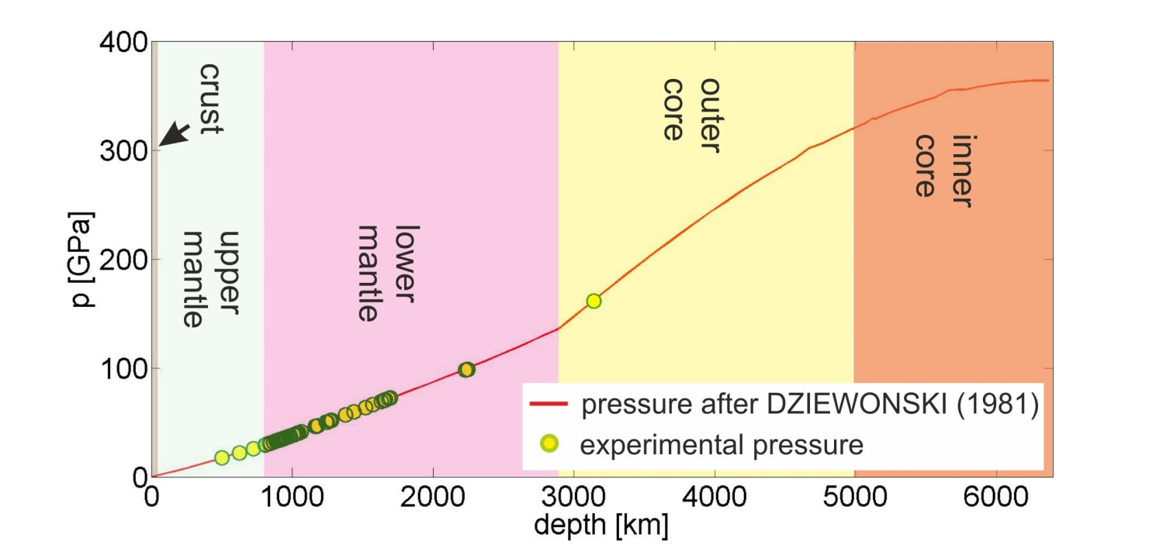
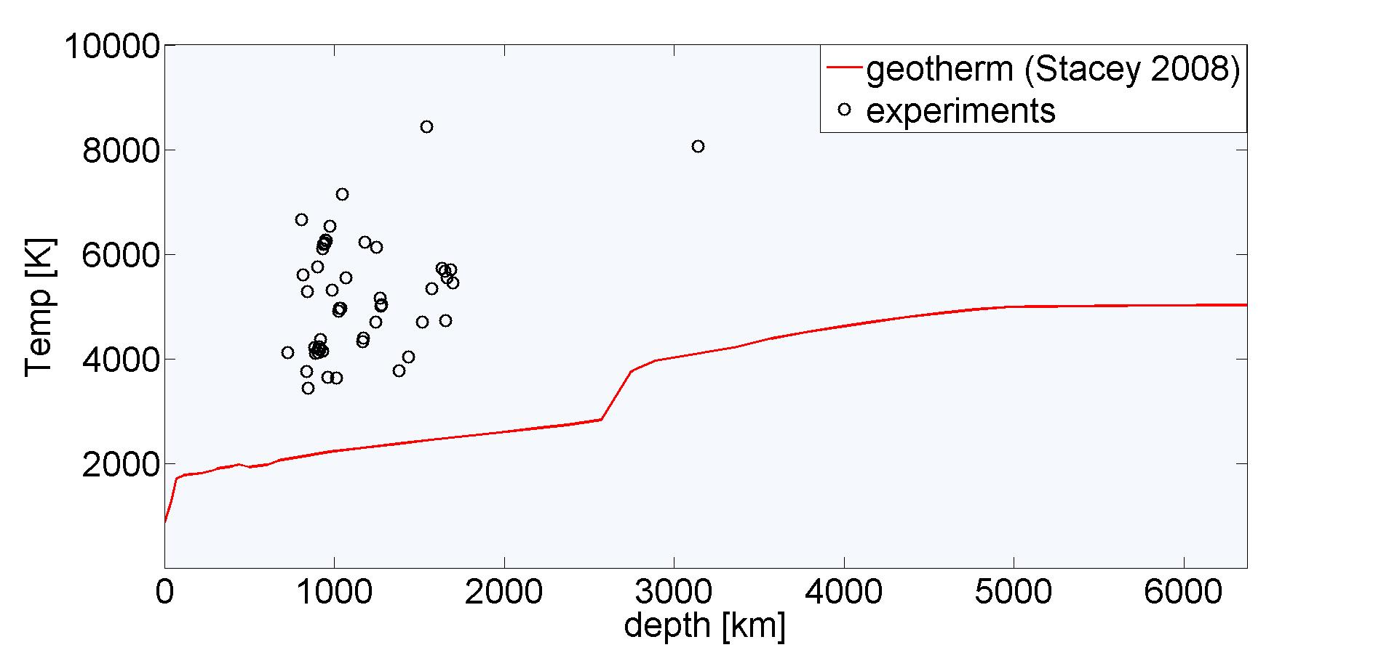
Experimental setup
Samples from the outer core?
4
TU Bergakademie Freiberg | Institut für Mineralogie | Professur für Mineralogie | Brennhausgasse 14 | Telefonnummer: 03731 / 39-3540 | www.tu-freiberg.de | Vortragender: Thomas Schlothauer| Кафедра взрывное дело | окт. 2013

Slide 5
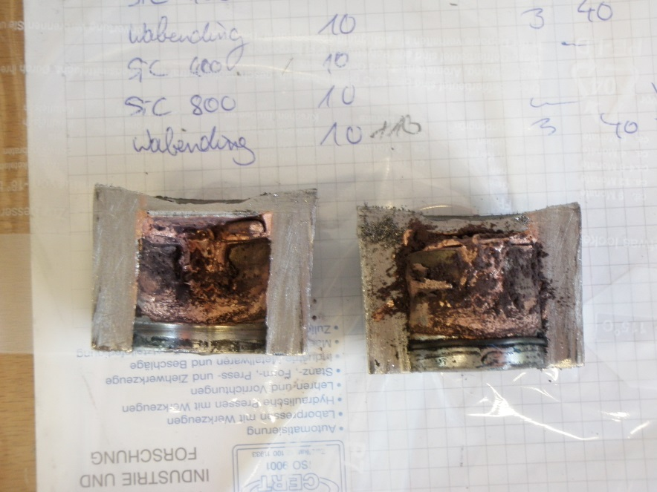
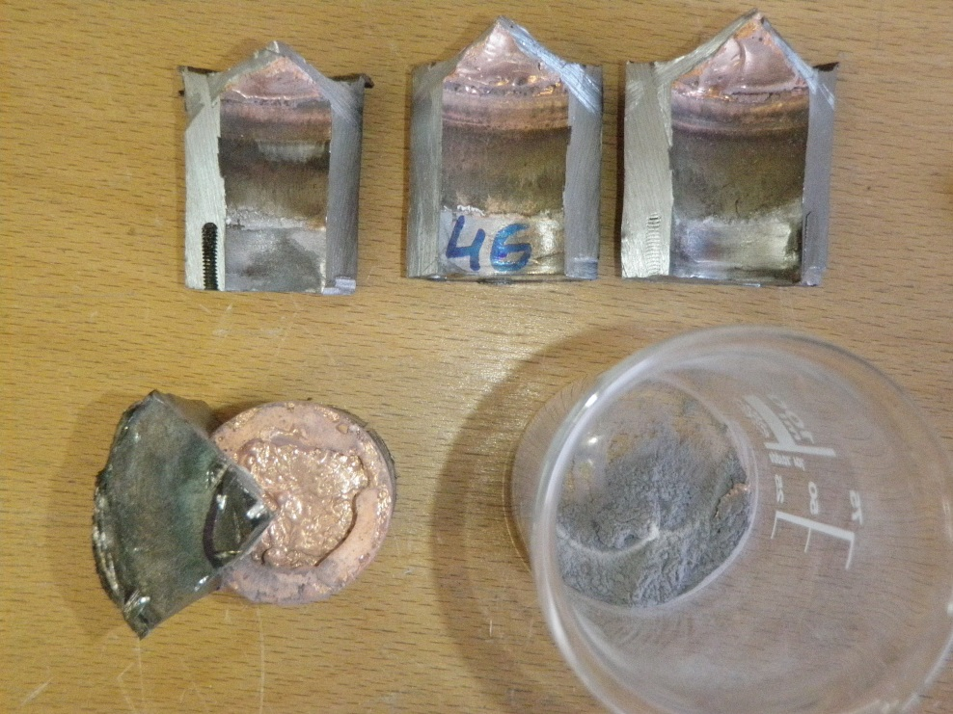
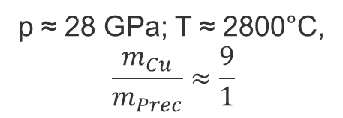
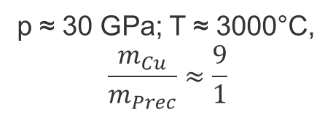
Motivation
p ≈ 28 GPa; T ≈ 2800°C,
$$\frac{m_{Cu}}{m_{Prec}}≈\frac{9}{1}$$
Behavior of the metal powder-
sample-mixture currently not well
solved (cooling rate, gaseous phases)
p ≈ 30 GPa; T ≈ 3000°C,
$$\frac{m_{Cu}}{m_{Prec}}≈\frac{9}{1}$$

Slide 6
Starting material
Isometric well rounded grains
Internal structure dominated by small
crystallites with different orientations,
surrounded by a thin skin

Slide 7
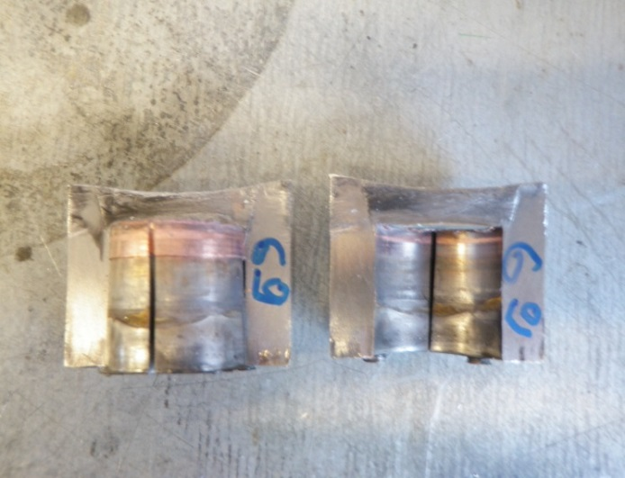
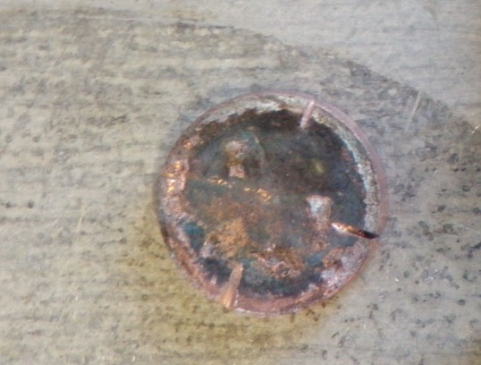
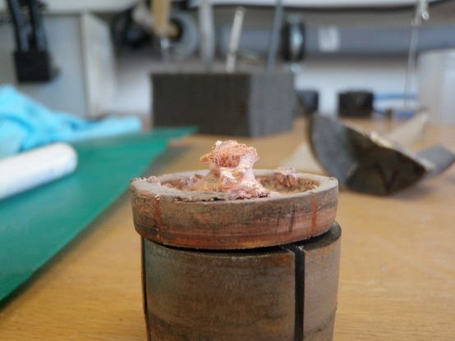
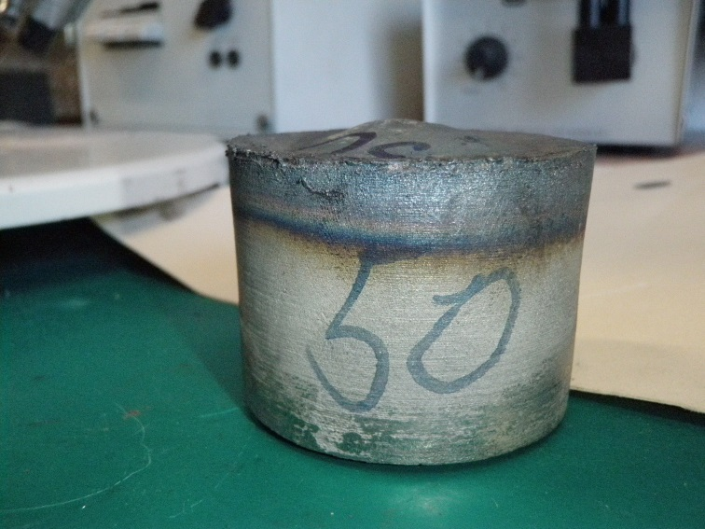
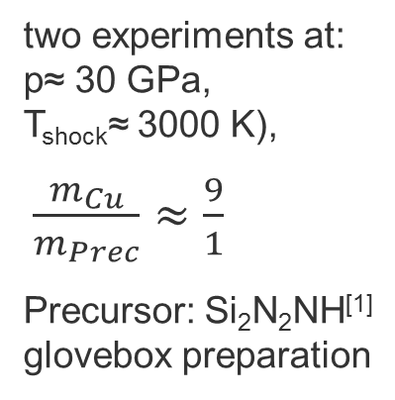
Experimental conditions
two experiments at:
p≈ 30 GPa,
T_{shock}≈ 3000 K),
$\frac{m_{Cu}}{m_{Prec}}≈\frac{9}{1}$
Precursor: Si₂N₂NH^{[1]}
glovebox preparation
Sample without
influence of
upstreaming jetting
Sample piston without
traces of copper
Sample with
influence of beginning
„upstreaming jetting“^{[2]}
top of the container arched
upward
[1] Schlothauer, T., M. R. Schwarz, M. Ovidiu, E. Brendler, R. Moeckel, E. Kroke, and G. Heide (2012), “Shock Wave” Synthesis of Oxygen-Bearing Spinel-Type Silicon Nitride γ-Si3(O,N)4 in the Pressure Range from 30 to 72 GPa with High Purity, in Minerals as Advanced Materials II, edited by S. V. Krivovichev, pp. 375–388, Springer Berlin Heidelberg. Berlin, Heidelberg.
[2]Gu, Y. B., S. Zhuang, M. Vural, A. Molinari, and G. Ravichandran (2010), Upstream jetting phenomenon in planar shock wave experiments with ceramic powders, Shock Waves, 20(5), 387–393.

Slide 8
Powder with adiabatic compression
complete melting, gas bubbles
separation of copper from the nitrides

Slide 9
Powder with adiabatic compression

Slide 10
x
Powder with adiabatic compression
x
y
z
solidification similar casting processes
slowly solidification
heat sink here rim of the sample holder
complex cooling behavior
phase separation between nitrides and copper
y
z
x

Slide 11
powder without adiabatic compression
1
1
2
molten rims only near vacuoles
11

Slide 12
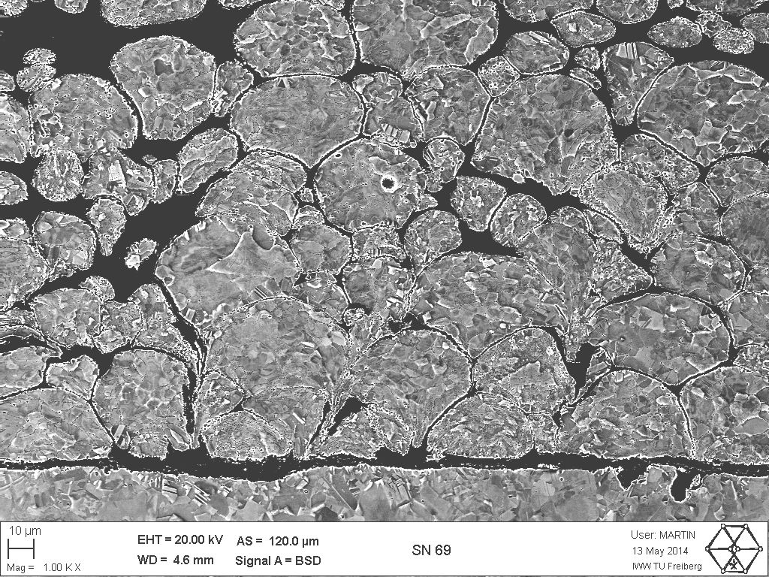
powder without adiabatic compression
grains without molten rims
strong mechanical deformation

Slide 13
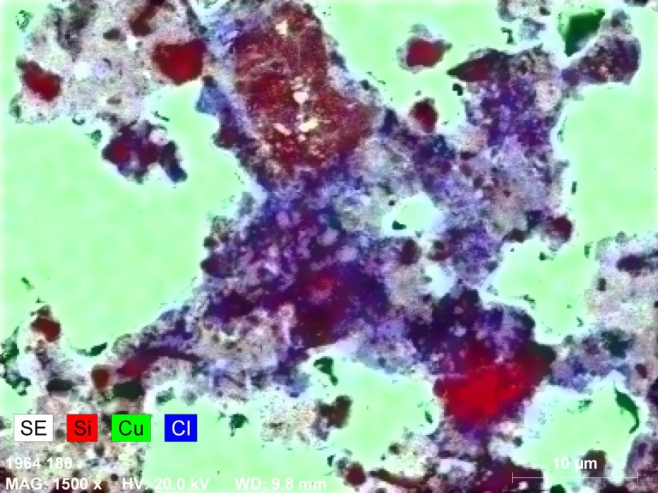
powder without adiabatic compression
separated fine grained HP-phases
gaseous phases concentrated in
vacuoles

Slide 14
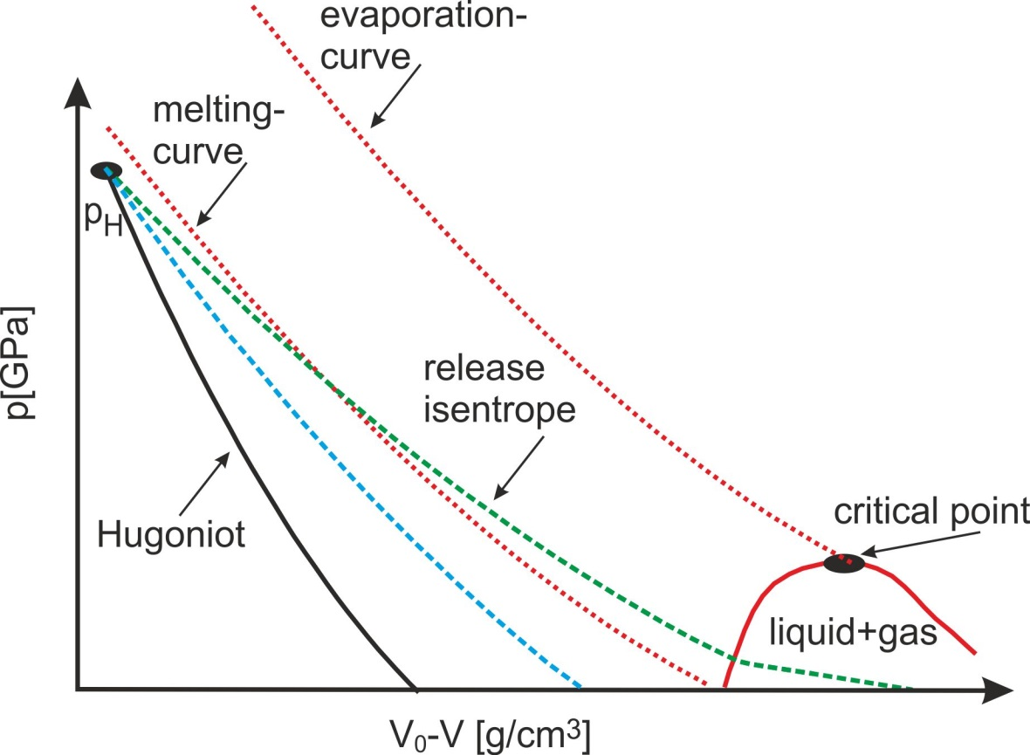

consequences
Cooling time depends strongly on the
intersection point between melting
curve and release isentrope
$$T=T_{shock}$$
for well controlled synthesis
conditions avoiding of the „melting
on the release path“ required
intensely contact between metal and
sample required

Slide 15
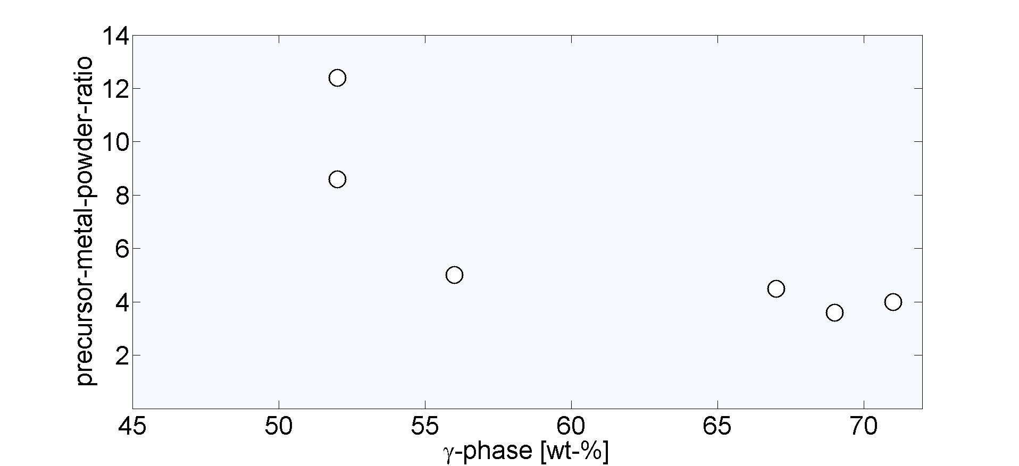
consequences
for γ-SiAlON (p ≈ 40 GPa, T ≈ 4000°C)
Inreasing synthesis succes with
decreasing metal powder-precursor-ratio

Slide 16
Conclusion
melting processes in the pressure range as shown does only on the
release path occur
increasing cooling time increase the probability of reconversion of HP-phases
metal powder and HP-Phases are strictly separated
gaseous phases are concentrated in vacuoles
reduction of the metal powder-sample-ratio increases the synthesis succes

Slide 17
Acknowledgements
The Dr. Erich-Krüger-Foundation for the financial support
The team of the Research and Teaching Mine „Reiche Zeche“
and „Alte Elisabeth“ for her engagement in the time of build-up and
also in the current time
V. V. Milyawskij († 2013), Paul S. DeCarli († 2013) and S. V. Razorenov for her
help to me understand more about the shock wave physics
Eberhard Voigt and Martin Voigtländer for high accuracy manufacturing
of our equipment

Slide 18
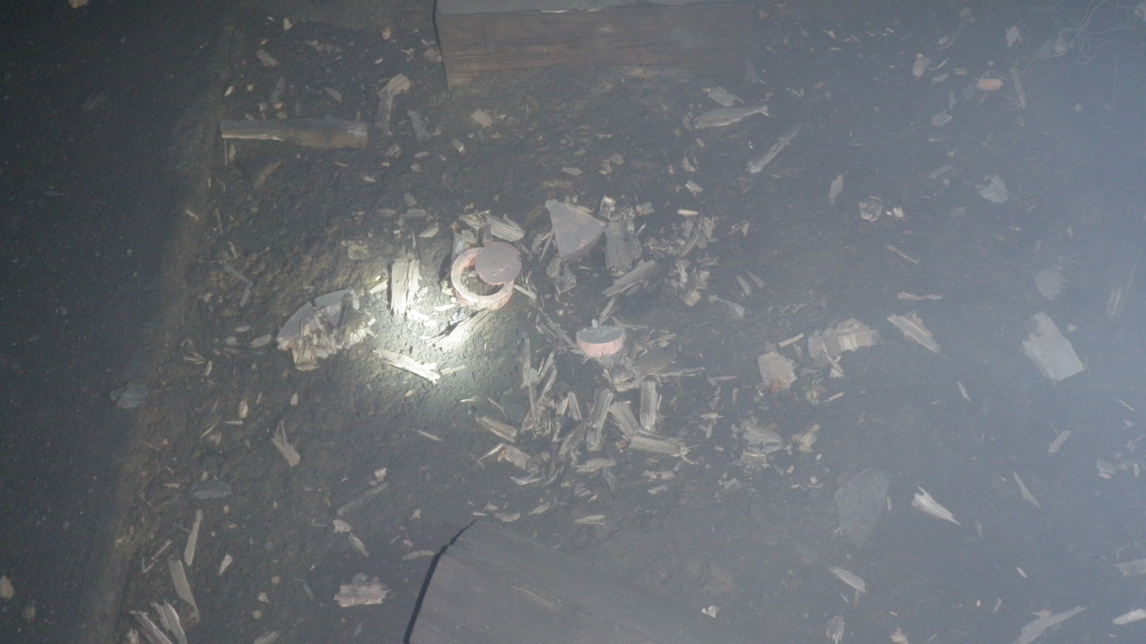
БОЛЬШОЕ СПАСИБО ЗА ВАШЕ ВНИМАНИЕ!!!!!
18
18

